Slide 1
Supporting the Delivery of Prevent in Scotland
Paul Wood
SG Connected Communities Unit
Paul.wood@scotland.gsi.gov.uk

Slide 2
Prevent is not new
Now completed Phase 5 of Delivery in Scotland
Aligned to existed Safeguarding Processes and Procedures

Slide 3
The role of Scottish Government
Connected Communities Division
Safeguarding and Vulnerability Team
Cohesive Communities Team

Slide 4
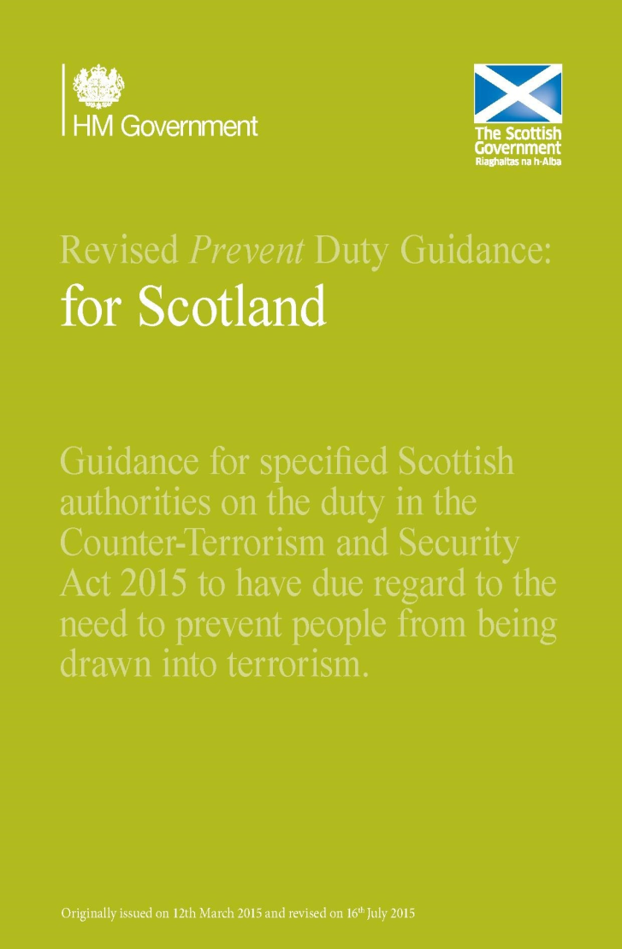
2015 UKG Counter Terrorism and Security Act
Prevent Duty placed on Scottish specified Authorities
Scottish Specific - National Prevent Duty Guidance
Available online

Slide 5
PPC Duty
Multi – Agency Approach to consider support required
Now responsibility of Local Authority to Chair
Bespoke training PPC modules offered by SG

Slide 6
Scottish CONTEST governance
UK Prevent Oversight Board
Prevent
Sub Group
Military
OSCR
UK Prevent sub-board
Care Inspectorate
HE
FE
Local
Authorities
Police
SPS
NHS
Education
HE Prevent
Working
Group
CDN
Safeguarding
Network
LA Prevent
SPOCs network
SOLACE
Prevent
Delivery
Units
Head of
Operations
Group
National
Resilience
Forum
Education Scotland
i) Curriculum
ii) Safeguarding Network
Independent schools
Multi Agency Local
CONTEST Groups
Communities

Slide 7
UK GOVERNMENT – CONTEST REVIEW
UKG to Publish Review – first time since 2011
What we know so far:
The 4 p’s structure of Prevent Pursue, Protect and Prepare will remain.
Significant uplift in Prevent resources
Move to more Proactive Communications Phase
Definite shift in language, greater focus on safeguarding

Slide 8
KEY ACHIEVEMENTS
CREATING A SAFE SPACE FOR DISCUSSION
Engagement with Schools
National Conversation Days
New materials on ES Hub
TRAINING OF FRONTLINE STAFF
WRAP 3
Multi Agency partnerships
Scottish Borders & Borders College
SPS and Police Scotland
NHS Greater Glasgow and Clyde

Slide 9
PRIORITIES GOING FORWARD:
Evaluation
Measuring success of Phase 5
Recommendations going forward
Engagement and Discussion
National Prevent Conference
Dialogue with Communities
Funding Opportunities

Slide 10
QUESTIONS?

