Slide 1
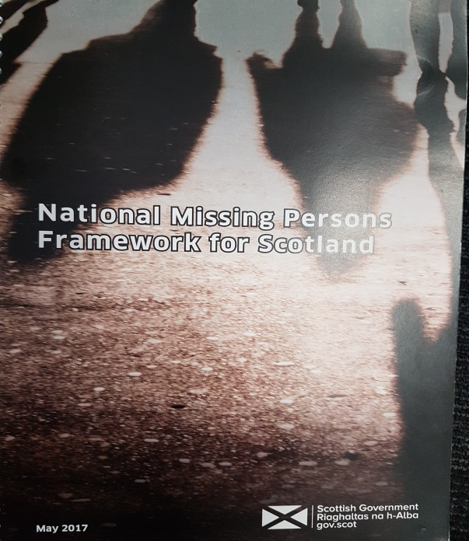
National Missing Persons Framework for Scotland

Slide 2
National Missing Persons Framework for Scotland
Scottish Government:
Began work in 2014 around Missing People and this included first work to develop the Framework.
Framework published in May 2017. www.gov.scot/Publications/2017/05/1901

Slide 3
National Missing Persons Framework for Scotland
Aims to:
Prevent people from going missing in the first place.
Limit the harm associated with people going missing.

Slide 4
National Missing Persons Framework for Scotland
April 2016 to March 2017 in Scotland:
40,248 calls to Police Scotland.
22,003 investigations.
110 calls per day resulting in 68 investigations per day.

Slide 5
National Missing Persons Framework for Scotland
What we know from 22,003 investigations in 16/17:
56% of investigations are for males
62% are for children (33% of those are children in care)
88% were found or returned within 48 hours
99% between 2 and 4 weeks
87 deceased

Slide 6
National Missing Persons Framework for Scotland
How do we meet the aims of the Framework?
Improvement of multi-agency working.
Some standardisation in a few key areas.
Flexibility to suit local areas needs.
Wider recognition of the issue.

Slide 7
National Missing Persons Framework for Scotland
Next Steps
Implementation Plan.
Oversight Group.

